Slide 1


Hii,
Iam Siddhika
Welcome to Power BI Series
Part -57

Slide 2


I’m very excited to dive into this with you all!
Are you ready to enhance your data visualization skills?
We focus only on the most used and important Visuals
Today Content
VISUALIZING DATA
BUILDING & FORMATTING CHARTS
BUILD MENU FORMAT MENU

Slide 3
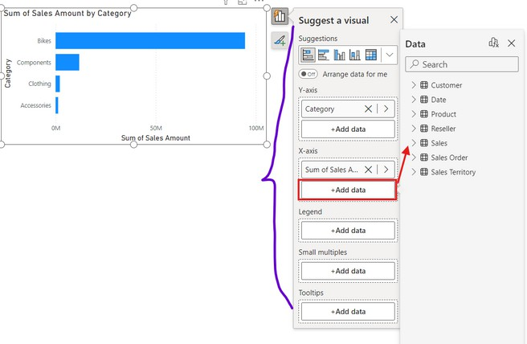


BUILDING & FORMATTING CHARTS
explore it?
Build menu
The Build menu lets you change the type of visual, get visual suggestions, and add data to customize chart components like the x-axis, y-axis, legend, and tooltips.
This menu is contextual, so it only shows options relevant to the selected visual element.
You can create visuals by either inserting a specific chart type and adding data, or by dragging a field from the Data pane onto the canvas.

Slide 4
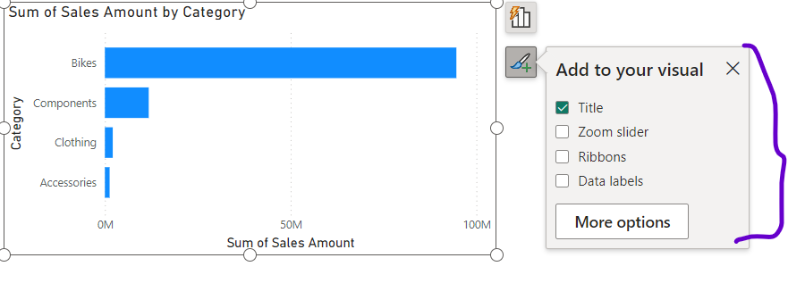


BUILDING & FORMATTING CHARTS
Go and exlpore
FORMAT MENU
The Format menu helps you easily add common elements to your chart, like titles, axis labels, data labels, and legends.
You can also find more options and settings in the Format pane.
This menu is contextual, meaning it only shows options that are relevant to the visual element you have selected.

Slide 5
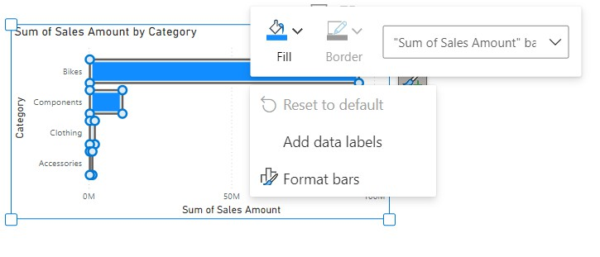

BUILDING & FORMATTING CHARTS
Why waiting just go and explore it?
Enable on-object formatting by double-clicking the chart object (or by right-clicking and selecting "Format"). This lets you select and edit individual chart elements.
On-object formatting is only available for certain visuals, such as bar, column, line, area, combo, and scatter charts.

Slide 6


Thank you for joining me today to learn about Part -57 of Power BI!
Remember, Effective data visualization is crucial for turning data into meaningful insights and compelling narratives with Power BI.
Stay tuned for more insights and tips on Power BI in our next Series.
Follow
Siddhika Shah

